Slide 1
Week 8: Linear Processing Filtering
(I’m Fun) Digital Image Fundamentals
Thuong Nguyen Canh
Institute for Datability Science, Osaka University
November 2019
This material is based on the Digital Image Processing, Stanford University, Prof. Bernd Girod.

Slide 2
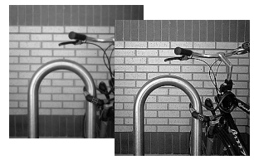
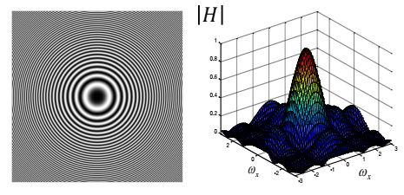
Contents
2D Linear systems
Separability
Shift-Invariant Linear System
Integral Image for fast box-filtering
2D Frequency response
Blurring and Sharpening
Zoneplate
Image sampling/aliasing
Wiener filtering
Nonlinear noise reduction/sharpening

Slide 3
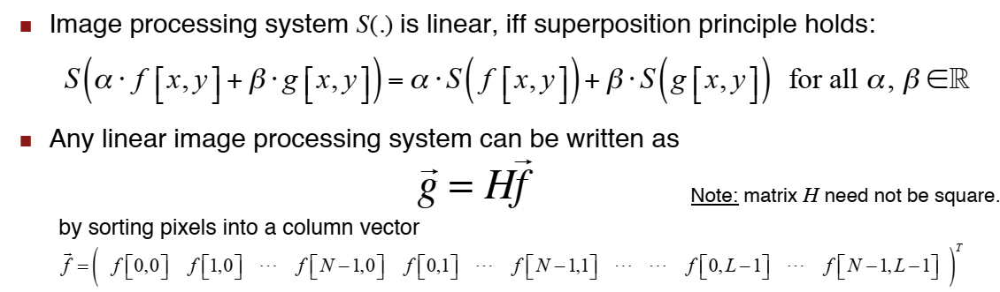
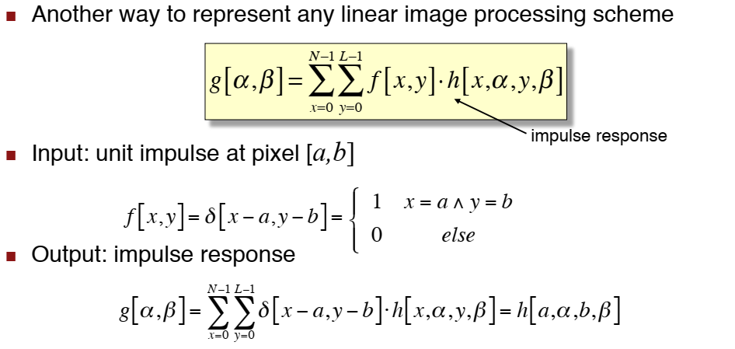
Linear Image Processing (1)
Impulse
response
(Đáp ứng xung)
https://vi.wikipedia.org/wiki/%C4%90%C3%A1p_%E1%BB%A9ng_xung
Notes:
Morphological image processing is a collection of non-linear operations related to the shape or morphology of features in an image.

Slide 4
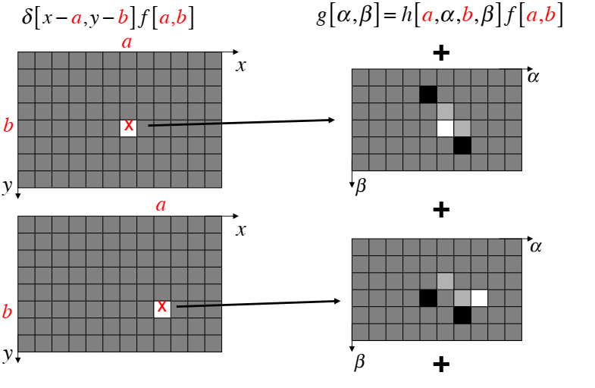
Linear Image Processing (2)
#1: Superposition of impulse responses

Slide 5
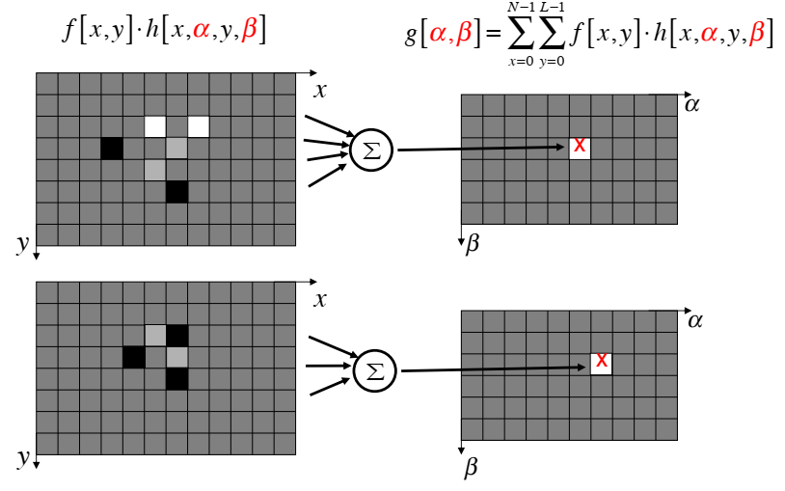
Linear Image Processing (3)
#2: Linear combination of input values

Slide 6
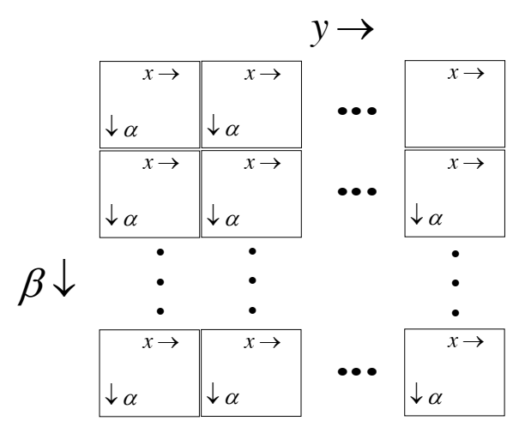
Linear Image Processing (4)
Relationship of H and h[x, α, y, β]

Slide 7
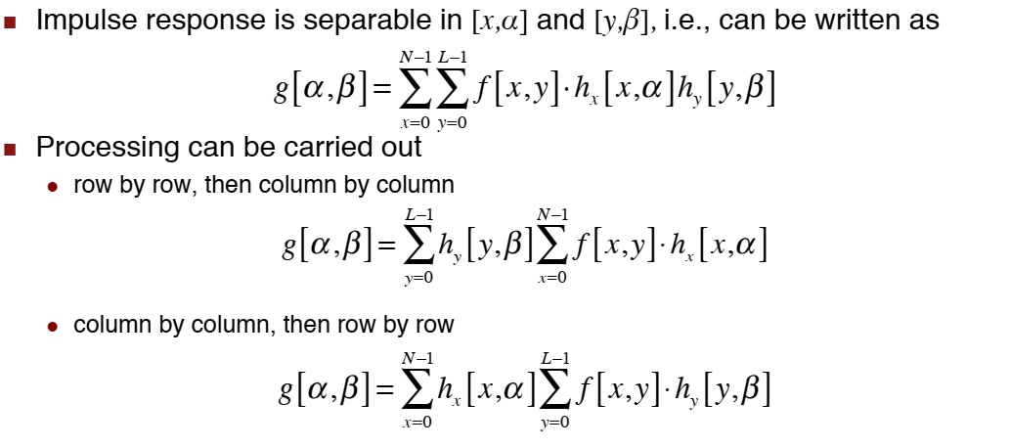
Separable Linear Image Process. (1)

Slide 8
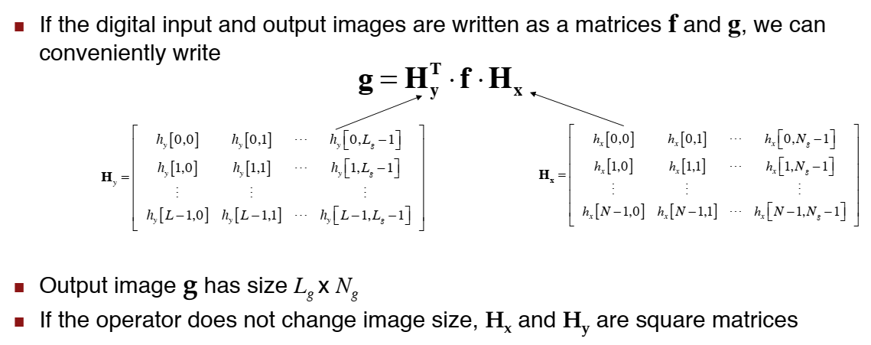
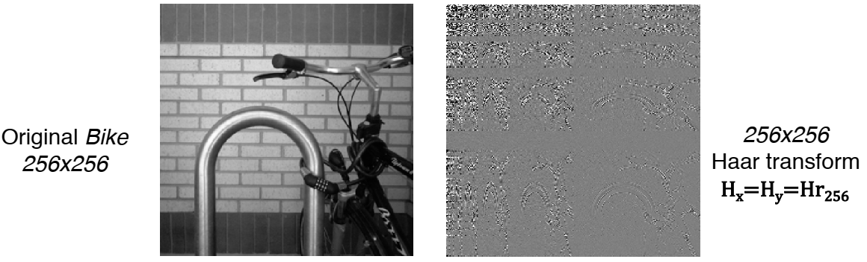
Separable Linear Image Process. (1)
Example

Slide 9
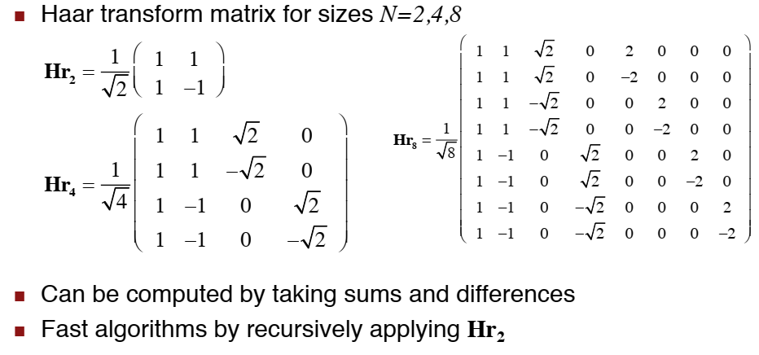
Haar Transform

Slide 10
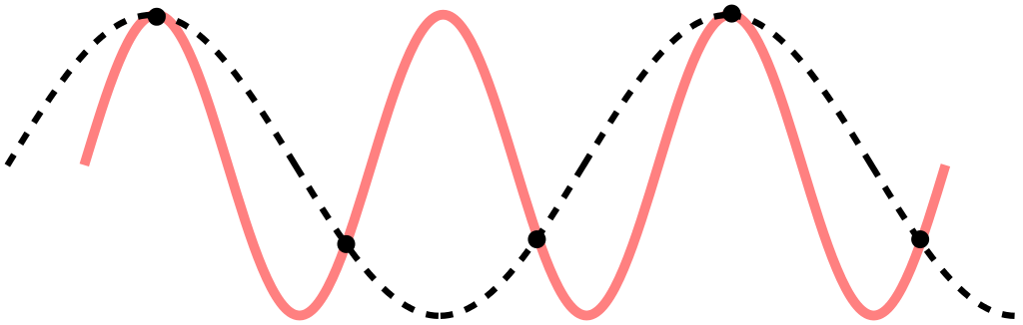
Sampling (1)
Nyquist sampling theorem
Aliasing
An effect that causes different signals to become indistinguishable (or aliases of one another) when sampled

Slide 11
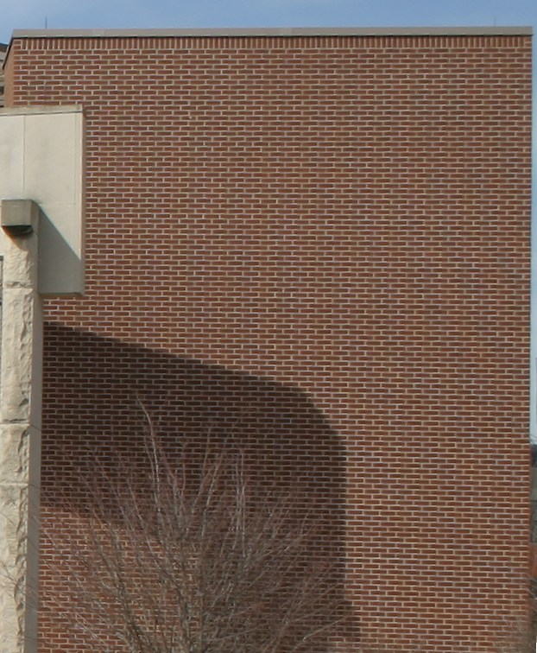
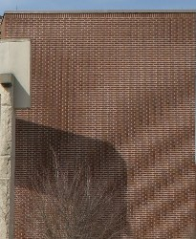
Sampling (2)
properly sampled image
Under-sampled image

Slide 12
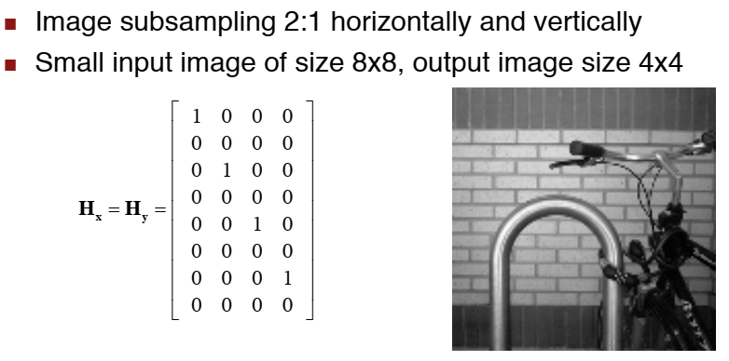
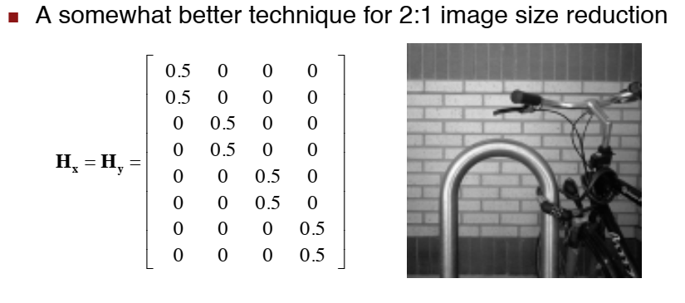
Sub-sampling (1)
A1
A2

Slide 13
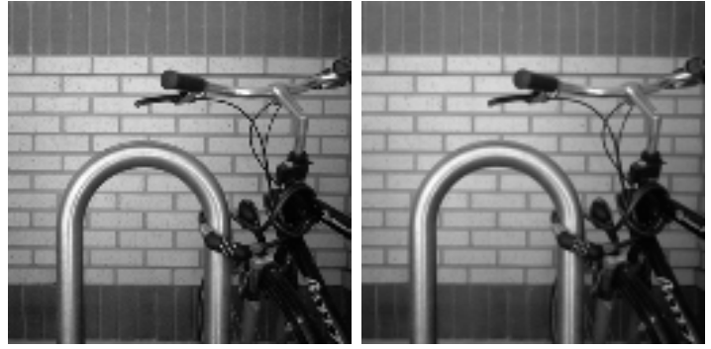
Subsampling (2)
A1
A2

Slide 14
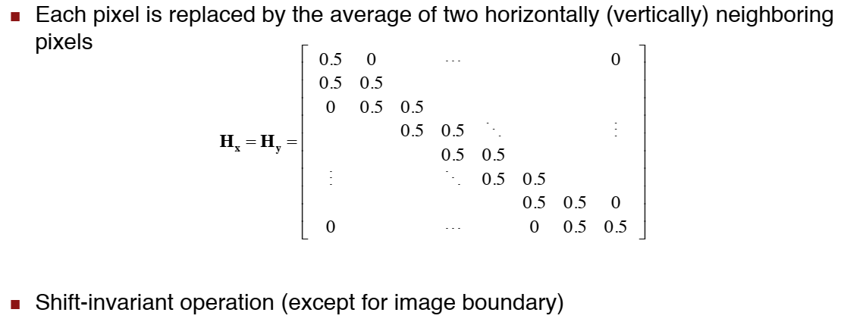
Another Example

Slide 15
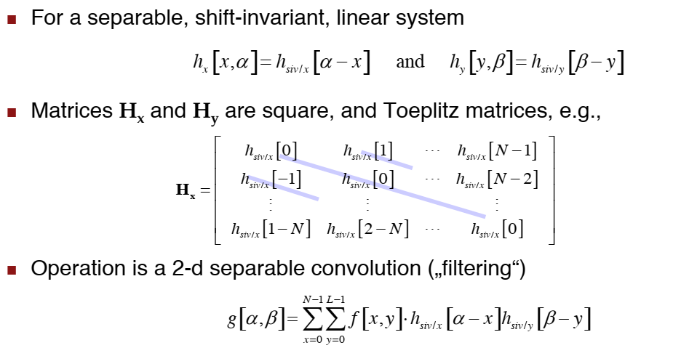
Shift-Invariant System & Toeplitz Matrices

Slide 16
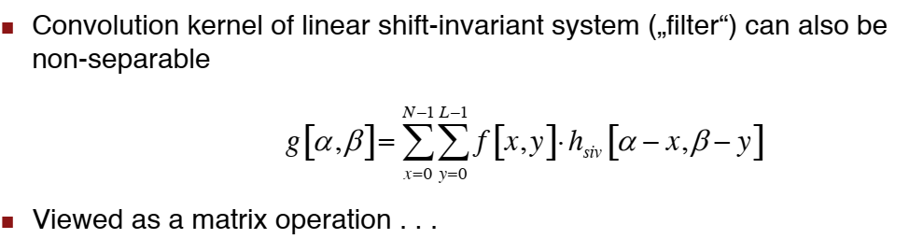
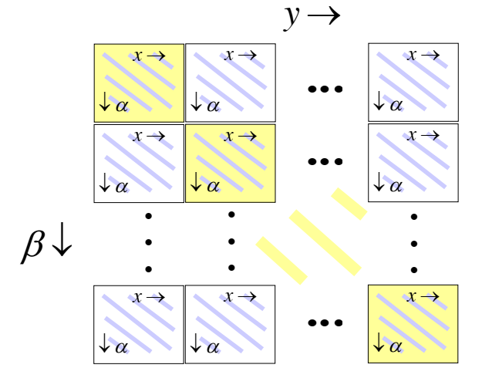
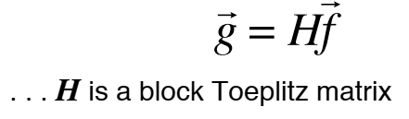
Non-Separable 2D Convolution

Slide 17
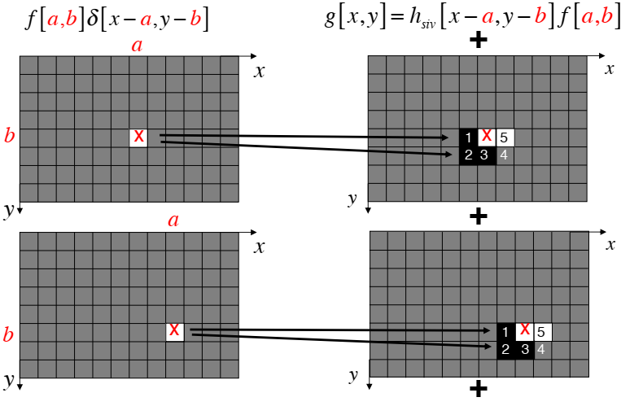
Non-Separable 2D Convolution
#1 Superposition of impulse response

Slide 18
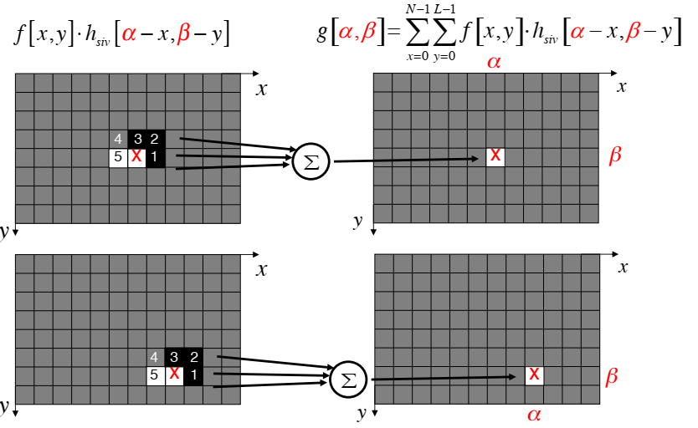
Non-Separable 2D Convolution
#2 Linear combination of neighboring pixel values

Slide 19
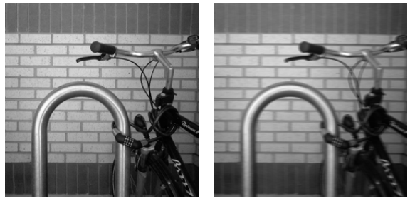
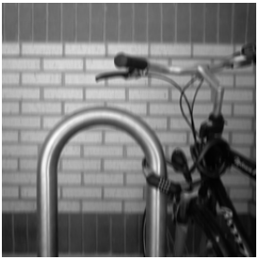
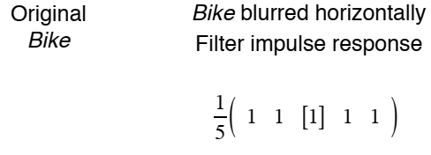
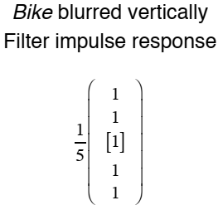
Convolution Example

Slide 20
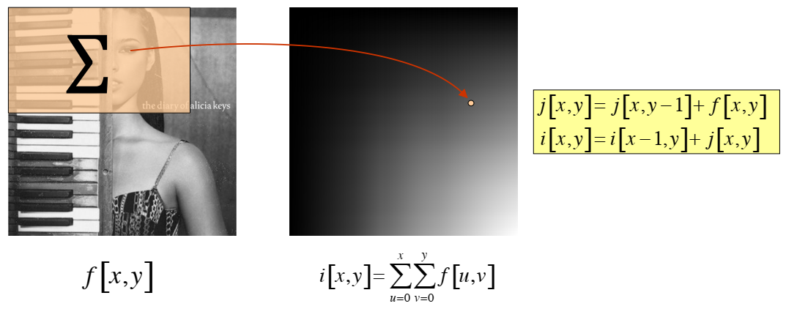
Integral Image
Derived via cumulative addition of intensity pixels in both horizontal & vertical
Image processing often process on a local region of images

Slide 21
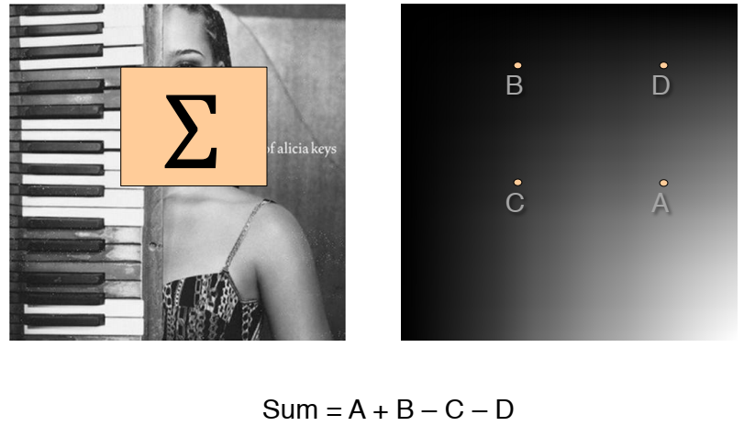
Box Filtering
An average-of-surrounding-pixel kind of image filtering.

Slide 22
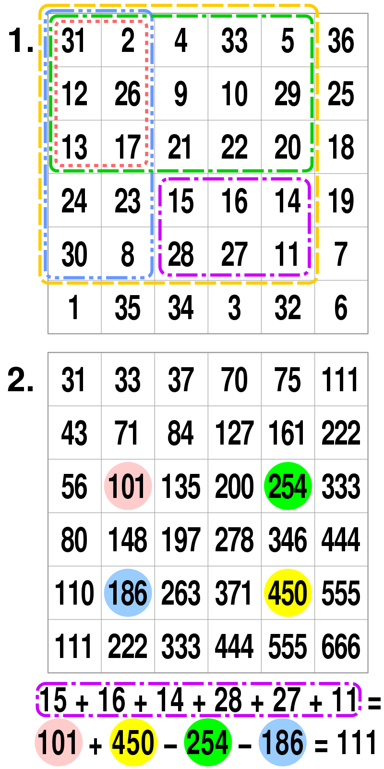
Box filtering
Example

Slide 23
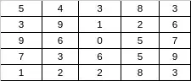
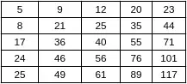
Why integral image
Summed-area table
Faster and less computation for large input size images
Normal Average: 9 operations
9 + 1 + 2 + 6 + 0 + 5 + 3 + 6 + 5 = 37
37/9 = 4.11
→ 100 average requires 100*09 = 900 operations
56 operations
Integral image
Integral image: 4 operations
(76 - 20) - (24 - 5) = 37
37 / 9 = 4.11
→ 100 operation requires 56 + 100*9 = 456 operations
https://www.quora.com/How-integral-image-is-used-in-image-processing-and-how-improves-the-computation-time

Slide 24
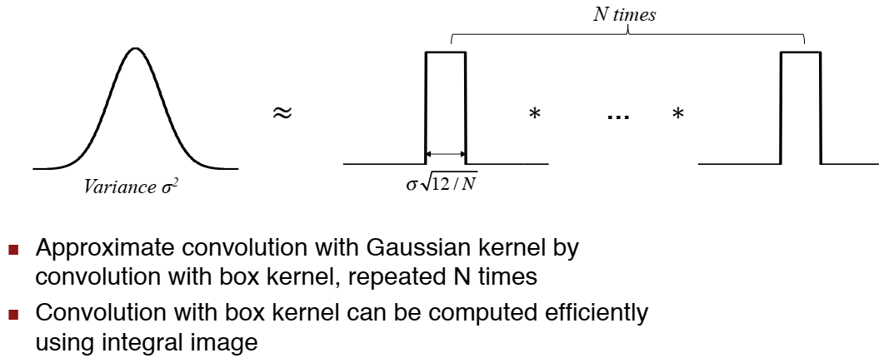
Gaussian Filtering by Repeated Box Filter

Slide 25
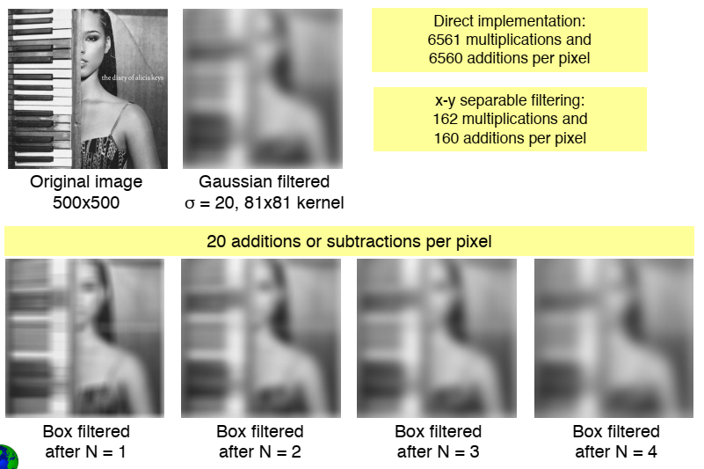
Gaussian Filtering by Repeated Box Filter

Slide 26
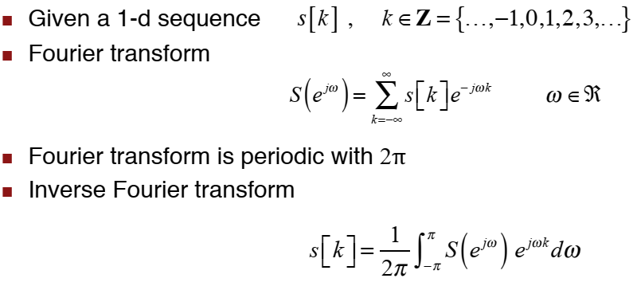
1D Discrete-Time Fourier Transform

Slide 27
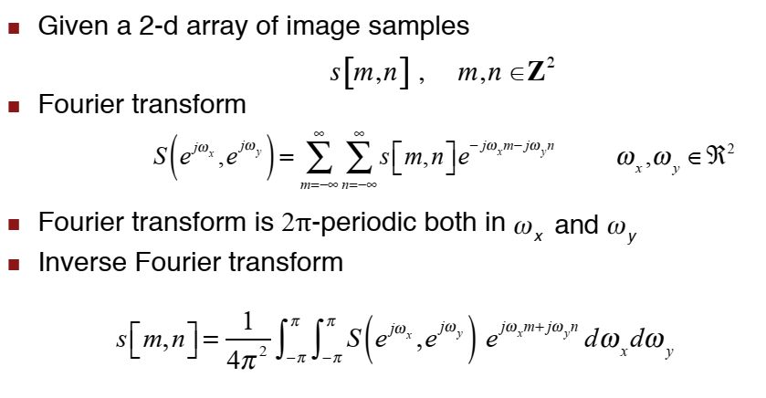
2D Discrete-Time Fourier Transform

Slide 28
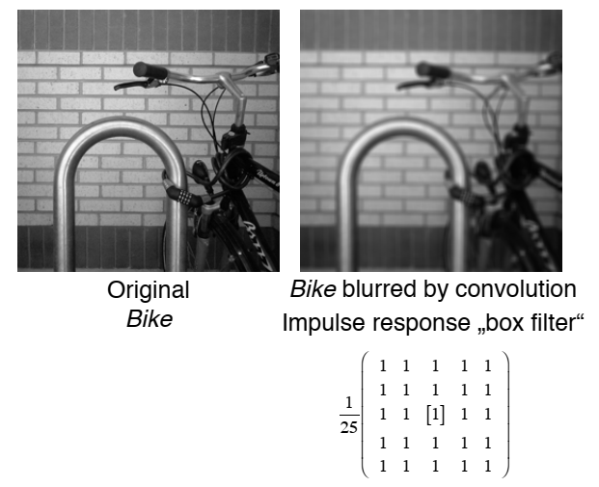
5x5 Box Filter Revisited

Slide 29
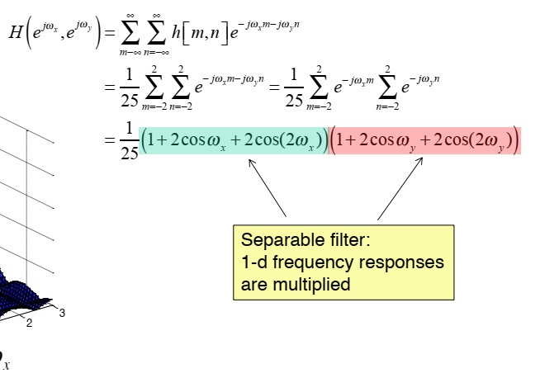
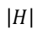
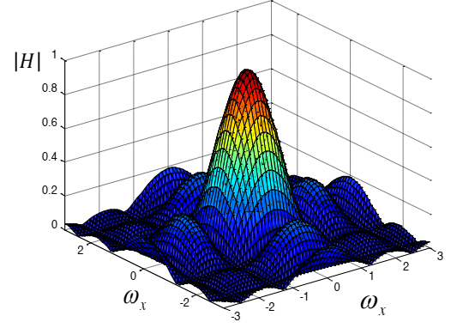
Frequency Response

Slide 30
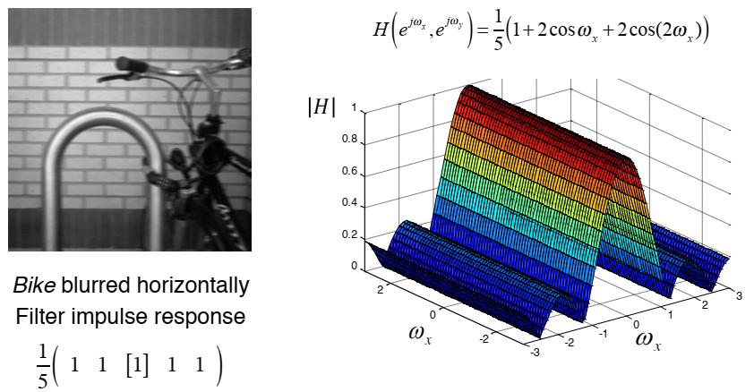
Horizontal Lowpass Filter

Slide 31
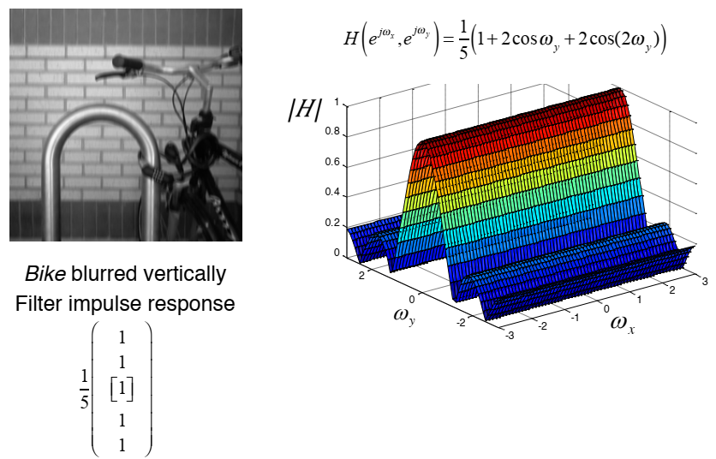
Vertical Lowpass Filter

Slide 32
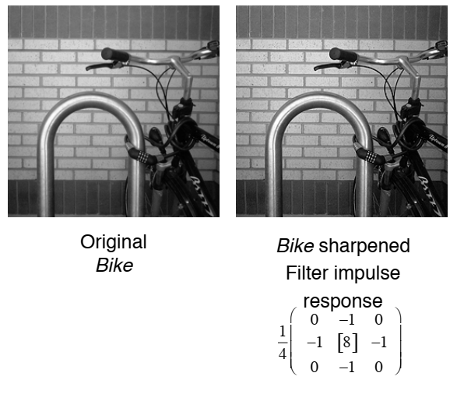
Sharping Filter

Slide 33
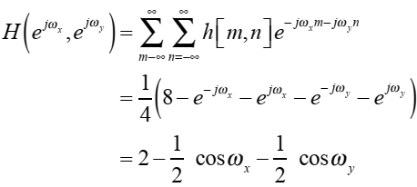
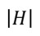
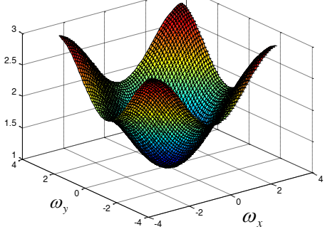
Sharping Filter (2)
Frequency response

Slide 34
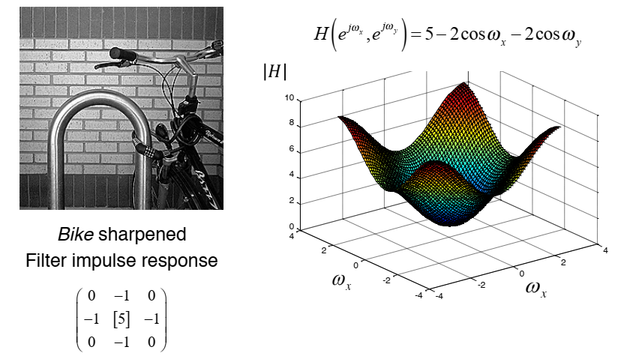
Sharping Filter (3)
More aggressive sharpening filter

Slide 35
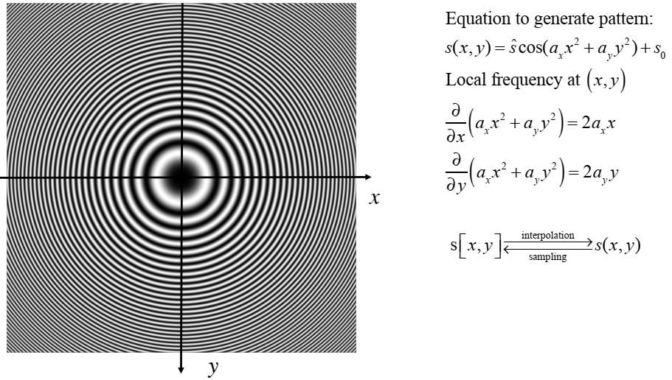
Zoneplate pattern
Used to visualize the frequency plane

Slide 36
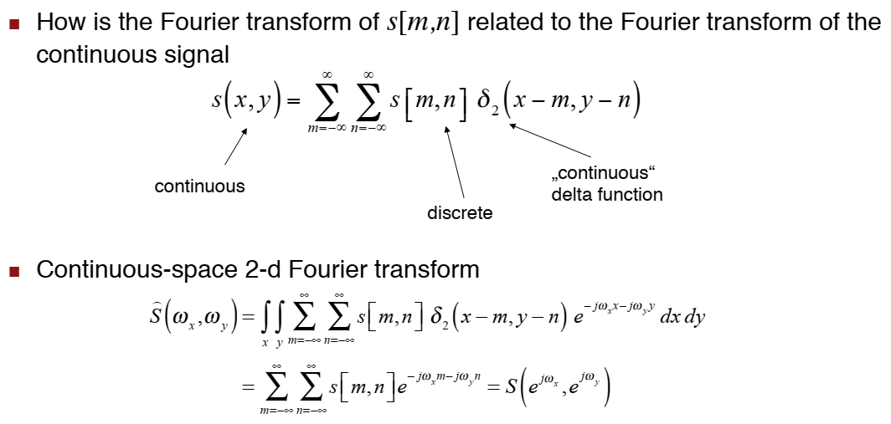
Sampling interpretation of 2D FT

Slide 37

Lowpass filtering

Slide 38



Zoneplate demonstration

Slide 39

Subsampling with prefiltering
Horizontal/Vertical 2:1 subsampling

Slide 40


Image magnification (10%)

Slide 41


Optical Anti-Aliasing filter
An anti-aliasing filter (AAF) is a filter used before a signal sampler to restrict the bandwidth of a signal

Slide 42



Blurry images

Slide 43

Blurry Images

Slide 44


Image Restoration
Recover the original image x from its degraded version y
Image Restoration is different from image enhancement
Image restoration:
recover the original signal from the degraded one
As close to the original signal as possible
Image enhancement:
Enhance the quality of image with a given criteria
i.e. sharpening, highlighting
Enhanced image is not as similar as the original images
$$y=Hx+n$$

Slide 45




Image Denoising
Recover the original image x from its noisy version y
H is an identity matrix → Image denoising
Depends on structure of noise
Random: Gaussian, Salt and Pepper, Poisson,
Structure: pattern noise, due to sensor/imaging structure, etc.
$$y=x+n$$
This is additive noise model
$$x, y, n∈ℝ^{n}$$
Denoise
H. Talbot et al., Efficient posson denoising for photography, ICIP 2009.

Slide 46





Image Deconvolution
Blurred image is a convoluted of a point spread function (PSF)
$$y=Ax+n$$
$$x, y, n∈ℝ^{n}$$
$$A∈ℝ^{n×n}$$

Slide 47





Image Inpainting
Restored missing value area with a given mask → remove unwanted object
$$y=M⨀x$$
$$x, y∈ℝ^{n}$$
$$M∈𝔹^{n×n}$$

Slide 48




Image Superresolution
Restore high resolution image from its lower resolution instance
$$y=Dx+n$$
$$x, y, n∈ℝ^{n}$$
$D∈ℝ^{m×n}$, m < n

Slide 49



Compressive Sampling
Captured image in a compressed form
$$x, y, n∈ℝ^{n}$$
$$y=Φx+n$$
$$Φ∈ℝ^{m×n}, m≪n$$
Reconstruction
Compressed measurement

Slide 50

Image Deconvolution

Slide 51

Image Deconvolution
Naïve approach

Slide 52



Wiener Filter
Optimal Mean Square Error filter for blurred and addivie noise
The original image spectrum is estimated by (in transform domain)
For image denoising (without blurring)
$$\hat{Y}=G\left(u,v\right)X(u,v)$$
Wiener filter become inverse filter at strong SNR
Signal to noise ratio
is the noise variance

Slide 53

Wiener Filtering

Slide 54

Review: Power spectrum & Cross spectrum

Slide 55

Wiener Filter (2)

Slide 56

Wiener filter for linear distortion and additive noise

Slide 57

Wiener filter for linear distortion and additive noise

Slide 58

Wiener filter for additive noise

Slide 59

Wiener filter for additive noise

Slide 60



Wiener Filter
Overview of Filters :Wiener Filter
Uses a pixel-wise adaptive Wiener method based on statistics estimated from a local neighborhood of each pixel.
The local mean: $µ=\sum_{i=1:9}{X_{i}}$
The local variance: $σ^{2}=\frac{1}{9}\sum_{i=1:9}{\left(X_{i}^{2}−µ^{2}\right)}$
$υ^{2}$ is the variance noise. If the noise variance is not given, Wiener filter uses the average of all the local estimated variances.
$$X_{5_out}=µ+\frac{σ^{2}−υ^{2}}{σ^{2}}\left(X_{5_in}−µ\right)$$

Slide 61
Motivation (2)
Overview of Filter : Wiener Filter
S. Kumar, P. Kumar, M. Gupta, and A. K. Nagawat, “Performance Comparison of Median and Wiener Filter in Image De-nosing”, International Journal of Computer Applications, Nov.2010, show performance of Wiener Filter:
Speckle Noise : 80%, Gaussian Noise: 70%, and Salt & Pepper Noise: 65%
Some papers indicate that Wiener Filter does not work well with object edges such as:
K. Krajsek and R. Mester, “The Edge Preserving Wiener Filter for Scalar and Tensor Valued Images,” Proc. of the 28th conference on Pattern Recognition, pp. 91-100, 2006.

Slide 62

Motivation (3)
Overview of Filters: Gaussian Smoothing Filter:
Using Gaussian mask.
Convolution the Gaussian mask with the noisy image for denoising.
With the fixed size of the Gaussian mask, the smoothness level can be controlled by the standard deviation’s of Gaussian function.

Slide 63
Motivation (4)
Usually compare performance of Median Filter with Wiener Filter [14].
Haven’t found out the paper that compares Wiener Filter with Gaussian Filter.
I myself construct a model to compare Wiener Filter with Gaussian Filter.
Noise : Gaussian Noise under the variety of Signal to Noise Ratio (SNR)
Window size of Filter: 3x3
Filters: Gaussian Filter and Wiener Filter.
[14] S. Kumar, P. Kumar, M. Gupta, and A. K. Nagawat, “Performance Comparison of Median and Wiener Filter in Image De-noising,” International Journal of Computer Applications, vol. 12, no. 4, pp. 27-31, Nov. 2010.

Slide 64
Motivation (5)
Quality of Reconstructed Image Lena using Wiener Filter, Gaussian Smoothing Filter under the impact of Gaussian Noise
Gaussian Filter is good for the low SNRs (Denoising is more important than preserving edge information).
Wiener Filter is good for the higher SNRs compared to Gaussian Filter.
This may be a reason to explain why should use Wiener filter to detailed image rather than Gaussian Filter.
Image | SNR | 5dB | 10dB | 18dB | 20dB
Lena | Wiener Filter | 23.97 | 31.08 | 35.62 | 36.36
 | Gaussian Filter | 24.26 | 30.51 | 33.82 | 34.19

Slide 65
SNR=6dB, Wiener Filter, PSNR=27.61 dB

Slide 66
SNR=6dB, Gaussian Filter, PSNR=27.60 dB

Slide 67
Motivation (6)
SNR=6dB,Wiener Filter
PSNR=27.61dB
SNR=6dB,Gaussian Filter
PSNR=27.60dB

Slide 68
Motivation (7)
SNR=10dB,Gaussian Filter
PSNR=30.51dB
SNR=10dB,Wiener Filter
PSNR=31.07dB

Slide 69
Wiener Filter
Unable to reconstruct frequency components which are degraded by noise
They can only suppress them
Wiener filters are unable to restore components for which H(u,v)=0.
Unable to undo blurring caused by bandlimiting of H(u,v).
Such bandlimiting occurs in any real-world imaging system.

Slide 70

Nonlinear noise reduction/sharpening

Slide 71

Nonlinear noise reduction/sharpening

Slide 72

Nonlinear noise reduction/sharpening

Slide 73

Highpass filtered images

Slide 74

Soft scoring function

Slide 75

Soft scoring of highpass filtered images

Slide 76

Linear vs. nonlinear noise reduction/sharpening

Slide 77
Reference
Video Lecture on “Introduction to Linear Image Processing,”
Iasonas Kokkinos
http://www.ipam.ucla.edu/abstract/?tid=11321&pcode=GSS2013

